Slide 1

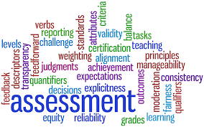
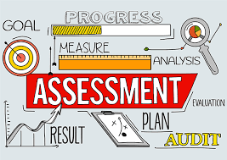
Basic Statistical and Measurement Consideration
Psychology and Test and Research Methodology

Slide 2

Measurement Concepts
As a counselor it does not matter whether you are developing assessments of your own or interpreting assessment findings, you must have an understanding of measurements in psychology.
We will talk more about these concepts in the next few slides
Basic Measurements Concepts Outline:
Scales of Measurement
Reliability
Validity
Test Development

Slide 3
Measurement Concepts
S C A L E S O F M E A S U R E M E N T: Different ways in which we measure assessment constructs
The 4 Scales of measurement
Nominal Scale:
Most Basic scale
Used for naming and classifying only
Ex: gender, 1-boy and 2-girl
Ordinal Scale:
Used to order or rank nominal categories
EX: 1-low satisfaction, 5-highly satisfied
Interval Scale:
Magnitude and equal intervals
Ex: Temperature; checklists of behaviors
Ratio Scale:
Magnitude, equal intervals, and an absolute zero
EX: Time and Height

Slide 4
Measurement Concepts
R E L I A B I L I T Y: Consistency of a test and how well it eliminates chance
M E A S U R E M E N T E R R O R: Positive or negative bias within an observed score
How reliable a test is depends on what the measurement error is
Equation of error impacting score: X=T+e
Types of reliability
Test-retest reliability
Alternate-form Reliability
Split-half reliability
Interrater reliability
Pages 92-95
Observed score
True
Score
Error score

Slide 5

Measurement Concepts
V A L I D I T Y: How meaningful or appropriate test findings are
Vs.
I N V A L I D I T Y: Threats to validity
There are a lot of different types of validity. Far too many to go into depth on each one. Listed below are the types of validity.
Face validity, content validity, criterion-related validity, concurrent validity, predictive validity, incremental validity, construct validity, convergent validity, discriminant validity, and treatment validity
Once again, read all about on types of validity on pages 97-101

Slide 6
Understanding and Transforming Raw Scores
Raw Scores
Simple number scores, such as 70 on a test
Derived Score
Obtained by taking the raw score and applying a mathematical trans
The raw score is then turned into a derived score
Norm-referenced: The comparisons of the socred that are obtained by other individuals
Criterion-referenced: The comparison of the absolute score that is established by the authority.
Self-Referenced: The comparison of the other score that are obtained by the same individual.
With Derived Score there are 3 comparisons:
Norm - Referenced
Criterion - Referenced
Self- Referenced
Definitions of the comparisons

Slide 7
Frequency Distribution
Histogram:Presents the Data in a frequency distribution that shows the format in a visual way
bar graph:Present the data in a visual nominal data
frequency polygon:Data that is presented in a line graph of frequency distribution
Measures of central tendency:A typical score or an average score that is indicated for a distribution of scores.
Some Key Words For This Chapter

Slide 8
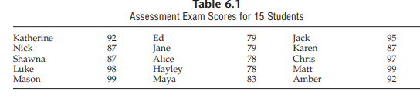
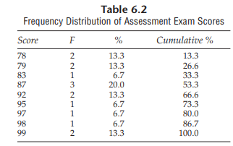
Understanding and Transforming Raw Scores
When looking at table 6.2 you will see that the frequencies are presented in a date format. The first column in order are in ascending order. The second column are in the frequencies. Third column are the percentages. The last column are the cumulative percentages. These data tables are easy to accumulate some general observations.
When looking at 6.1 you will notice the frequency that are being distributed in a column row format. In this chart, you would just calculate the frequencies by adding each individuals scores then dividing it by the total number of individuals .
Frequency Distribution- Is the total number of observations per distinct responses that are formed by a particular variable.

Slide 9
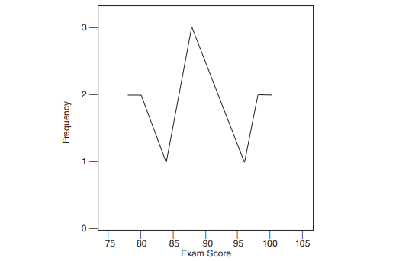
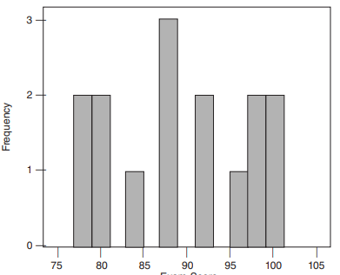
Understanding and Transforming Raw Scores
When trying to understand the measurements of the central tendency, you need to find the mode, mean.
There are three measurements of the central tendency, which also can be computed.
Mean: You have to add all of your numbers together and then divide it by the amount of numbers that you have. Also known as the average.

Slide 10
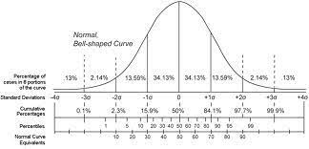

Norms and Ranks
There are two types of Developmental Norms
First
Developmental norms: A comparison between an individual’s score to the individuals grade level or the age age group.
Second
Grade Equivalent: Used on educational achievement test to see how well the students are progressing in their grade levels.
Age Comparisons: When individuals are being compared to other individuals in the same age group. Also, the second Developmental Norm.

Slide 11


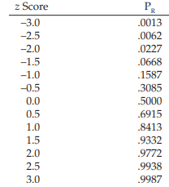

Standard Score
Standard Score: Defined as a score expressed as a distance, also in standard deviation unit, between the raw score, and mean.
Some of the main units to indicate score are Z score, T Scores, CEEB scored, Deviation IQs, and stanines.
Z scores: uses to estimate where the raw score could fall on a normal curve.
How you would find the Z score, you would have to subtract the raw score from the mean and then divide it by the standard deviation of the distribution

