Slide 1
Initial Psychological Assessment

Slide 2
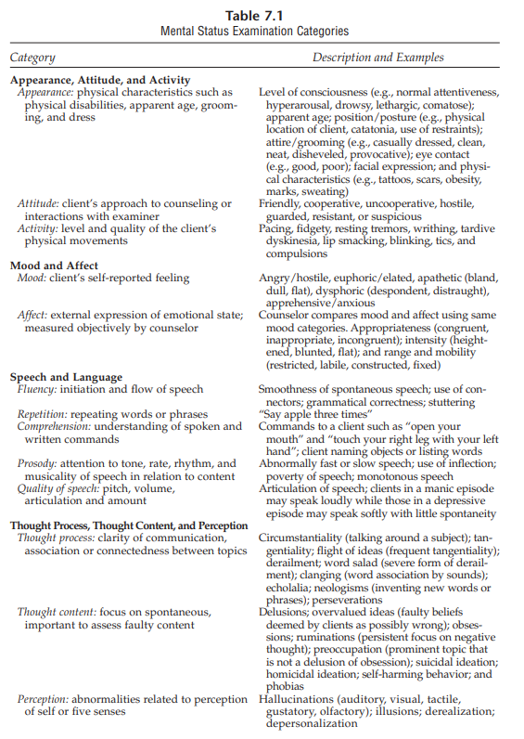
Conducting an MSE
When conducting a MSE counselors do the following
Self-Report screening
The MSE results can lead to
Overall view of a client
Counselor ask about the wide range of symptoms they are experiencing

Slide 3


Inventory of Common Problems
Inventory of Common Problems: College counseling centers use this for a screening instrument.
The result from the test would allow the counselor to readminister the ICP and be able to see the progress happening from the course of counseling.

Slide 4
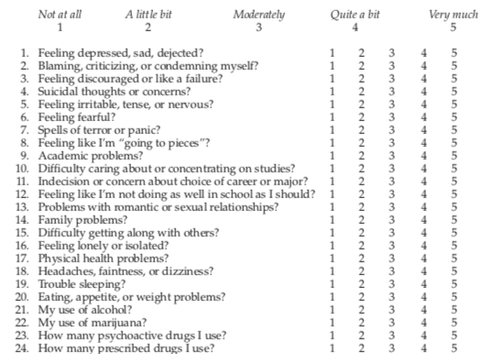
Symptom Check list–90–Revised
Symptom Checklist-90-Revised: Is collected research for clinical purposes in a mental health settings. There are 90 symptoms. They use this to allow students to report some common problems that can occur in some college students. They ask a list of question on a ranking from one to five. You only get 15 mins to complete it.

Slide 5
Brief Symptom Inventory, Derogatis Psychiatric Rating Scale
The brief symptom inventory also known as the (BSI) contains only 53 of the items on the symptom checklist 90.
Derogatis Psychiatric Rating Scale, SCL-90 Analogue, and the BSI are used for the clinician ratings of the same symptom list but with lesser time.
Unlike the SCL-90 where you get 15 minutes, you only get 10 minutes to complete the check-list.

Slide 6

Outcome Questionnaire 45.2
The outcome questionnaire is a 45 item self report used to screen for client affect.
It also shows the outcome of the clients interpersonal concerns and level of functioning in life.
The questionnaire gives a score and three subscale scores.

Slide 7
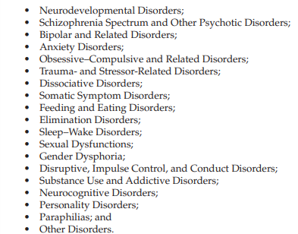
Diagnostic and Statistical Manual
Diagnostic and Statistical Manual: This provides Psychological disorder and psychiatric.

Slide 8
Inventories for Assessing Mental Disorders
Most of the inventories are used mainly for psychiatric diagnoses. These mainly contain the Psychiatric Diagnostics screen questionnaire and the patient health questionnaire.
The difference between the PDSQ and the PHQ are that they have different amount of scales that they relate to on Statistical manual.

Slide 9
Significant Factors in Suicide Risk Assessment
The main important component of the initial assessment in counseling is the suicide risk assessment.
There are a general population that 40% of those asked have a period of suicidal thinking at some time in their lives.
When in a counseling session a client should be asked directly if they are having suicidal thoughts if they hint they are thinking suicide thought.

Slide 10
Assessment of Alcohol Abuse
Some of the main substance disorders come from alcohol. Most of the substance assessments are mainly about alcohol abuse.
The percentage of alcohol abuse in a group of 119 was 31% of the students in the college.
One of the main issues that come from being asked about drinking comes from denial.

Slide 11
Michigan Alcoholism Screening Test
The questionnaire takes about the max of 15 mins to complete. It is a total of 25 questions. You have to answer the question with yes or no answers.If you score more than 5 that indicates alcoholism and if you score a 4 it indicates the possibility of alcoholism, and if you score a 3 or less that shows no alcoholism.
The screening test is a group of questions asking about intaking alcohol. They ask about getting into fights, the number of intake a day, have you ever went to the hospital because of drinking, and etc.
When taking the questionnaire if the client has any negative responses to the questions, that usually indicate alcoholism.

Slide 12
